Slide 1
COVID-19 Host Genetics Initiative meta-analysis

Slide 2
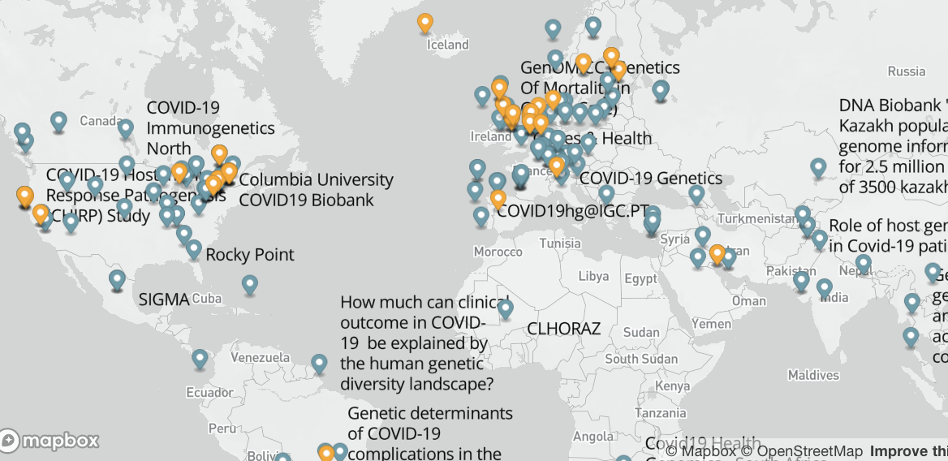
UK Biobank – UK
VA Million Veteran Program – US
deCODE genetics - ISL
Finngen - FI
Estonian Biobank – EST
Genes & Health – UK
Lifelines – NL
Rotterdam Study - NL
The Generation R study – NL
UK Blood Donors Cohort – UK
UK 100,000 Genomes Project – UK
Michigan Genomics Initiative - US
Netherlands Twin Register – NL
Qatar Genome Program – QAT
Mass General Brigham - Host Vulnerability to COVID-19 – US
Generation Scotland – UK
UCLA Precision Health COVID-19 Biobank - US
GeneRISK – FIN
Penn Medicine Biobank - US
Biobanque Quebec COVID19 - CA
Genetic determinants of COVID-19 complications in the Brazilian population - BR
Genomic epidemiology of SARS-Cov-2 2019 (COVID-19) and host genetics in Coronavirus Disease – Stanford - US
Amsterdam UMC COVID study group - NL
The genetic predisposition to severe COVID-19 - SWE
GenOMICC (Genetics Of Mortality in Critical Care) – UK
Genetic modifiers for COVID-19 related illness - BEL
GEN-COVID, reCOVID - ITA
Corea (Genetics of COVID-related Manifestation) - KOR
Determining the Molecular Pathways and Genetic Predisposition of the Acute Inflammatory Process Caused by SARS-CoV-2 - ES
Bonn Study of COVID19 genetics - GER
COVID19-Host(a)ge – ES + ITA
Helix Exome+ COVID-19 Phenotypes - US
AncestryDNA COVID-19 Research Study – US
23andMe - US
34 studies from 16 countries.
~15% of all registered studies
30,937 COVID-19 positive cases among
> 1.7 million individuals

Slide 3
New data freeze this week, 24 studies uploaded this far
BQC19
BRACOVID
CGI
CHULACOVID
CU
EstBB
FHoGID
GCAT
GENCOVID
GFG
GHS_Freeze_145
Genetics_COVID19_Korea
Genotek
HUNT
idipaz-24genetics
INMUNGEN_COV2
INTERVAL
Lifelines
Stanford
SweCovid
TOPMed_CHRIS10K (eurac)
TOPMed_Gardena (eurac)
UCLA
UKBB

Slide 4
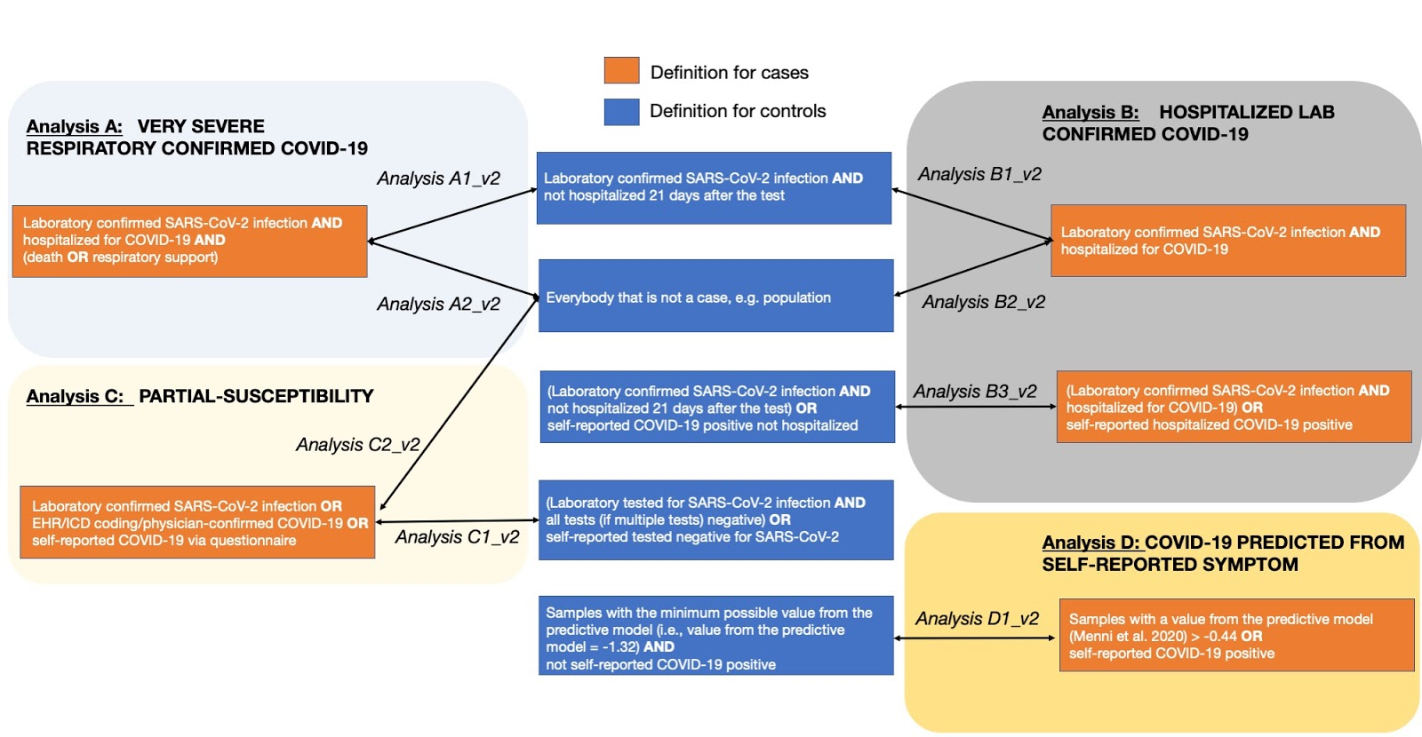
Sample size
CA=4,933
CO=1,398,672
CA=8,638
CO=1,736,547
CA=30,937
CO=1,471,815
CA=3,204
CO=35,728

Slide 5
B1: hospitalized COVID19+ vs non-hospitalized COVID19+
CA=1,389
CO=5,879
C1: COVID19+ vs lab/self-reported COVID19-
CA=11,181
CO=116,456
D1: predicted COVID19+ from self-reported symptoms vs. predicted or self-reported COVID19-
CA=1,777
CO=18,895

Slide 6
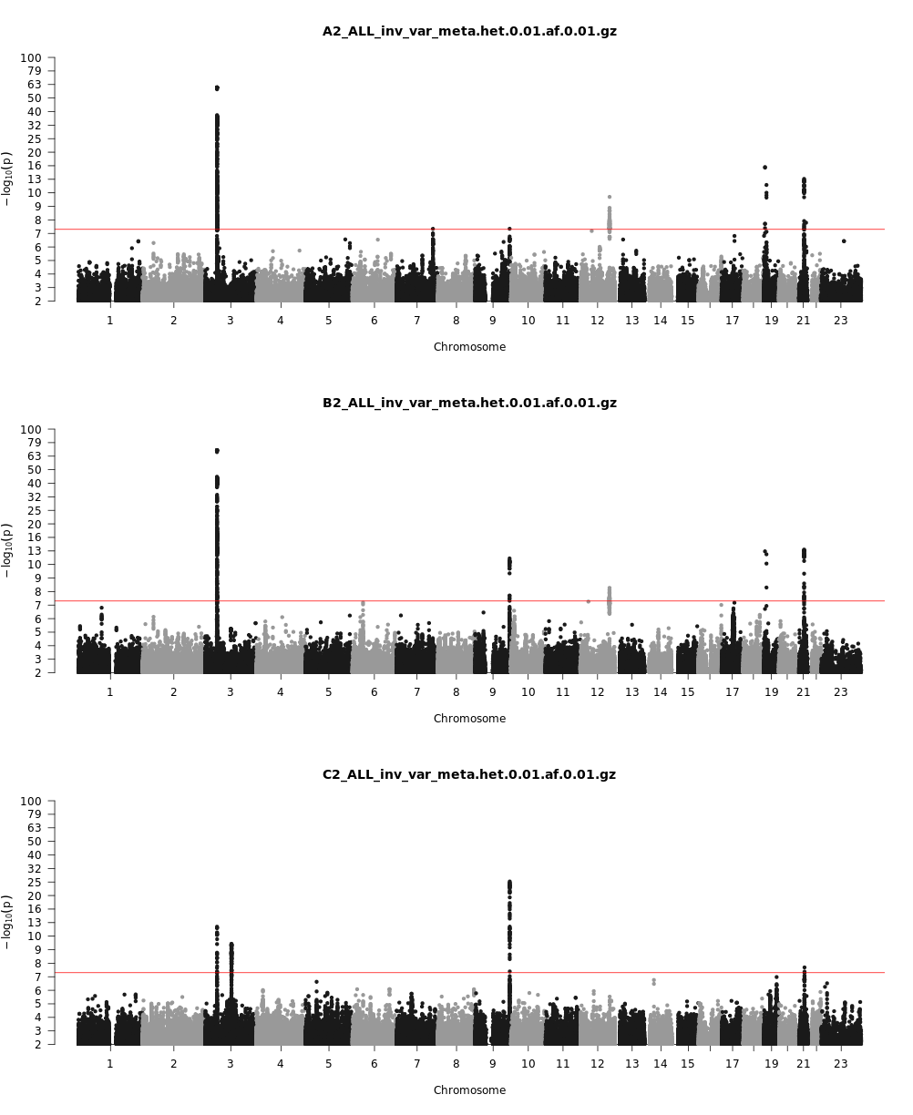
A2: severe COVID19+ vs population controls
CA=4,933
CO=1,398,672
B2: hospitalized COVID19+ vs population controls
CA=8,638
CO=1,736,547
C2: COVID19+ vs population controls
CA=30,937
CO=1,471,815

Slide 7
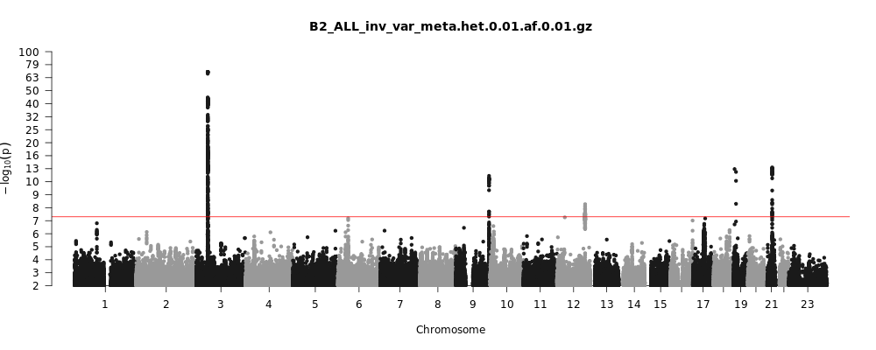
COVID-19 HOSPITALIZATION
OAS 1/2/3 gene cluster
SNPs span IFNAR2, IL10RB, IFNAR1 potentially IFNAR2:F10V
Top SNP rs2269899
Beta= .12, p=5.3e-9
Top SNP rs13050728
Beta= -.16, p=1.2e-13
Top SNP rs67959919
Beta= .59, p=1.6e-70
Many candidates:
Pot. eQTL to SLC6A20, CXCR6, CCR1
Likely TYK2 P1104A
Top SNP rs74956615
Beta= .32, p=1.3e-12
<20 k from TSS FOXP4
Lung cancer GWAS hit
Top SNP rs4714474
Beta= .36, p=6.3e-9
Intronic DPP9
ILD/IPF GWAS hit
Top SNP rs2277732
Beta= .16, p=3.2e-13

Slide 8
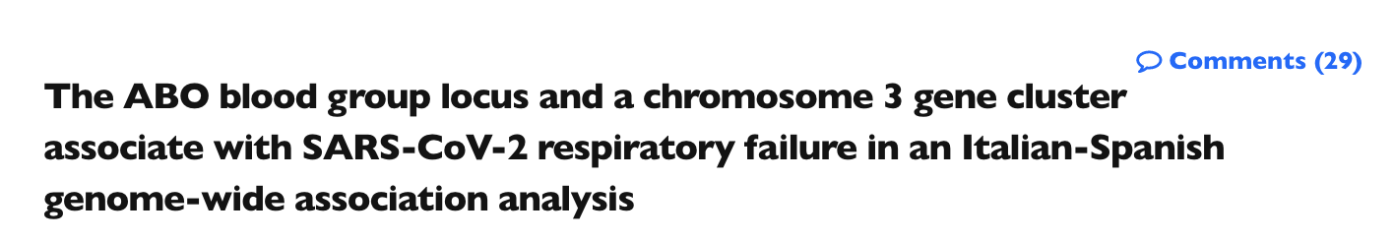

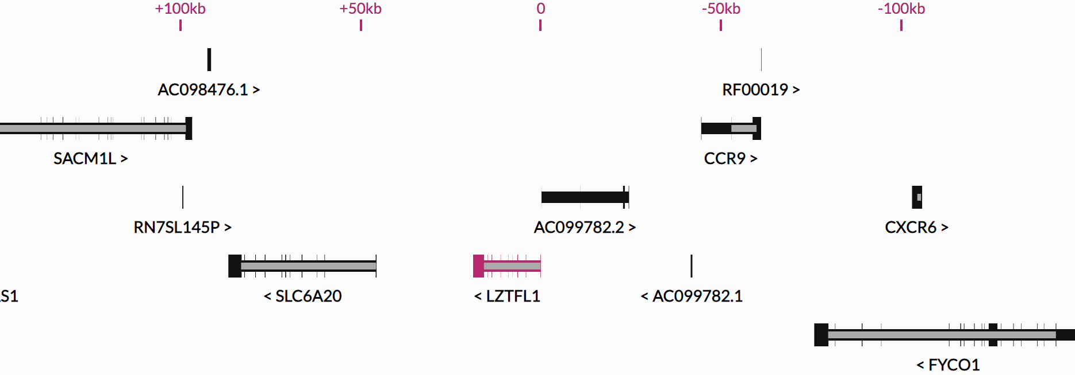

1st Association – chr3
June 2
Adjacent to major chemokine receptor cluster
No obvious functional variants in credible set
COVID-19 severity alleles colocalize with GTEx eQTLs for:
SLC6A20 (increased expression)
CXCR6 (decreased expression)
(possibly also CCR1)
AA Transporters SLC6A19 (B0AT1) and SLC6A20 (SIT1) require ACE2 for expression
CXCR6 may be involved T-cell recruitment/retention - ligand CXCL16 constitutively expressed in lung (a number of papers on these genes in lung infection response)
Top SNP rs67959919
Beta= .59, p=1.6e-70

Slide 9
FOXP4 locus (chr6 @ 41.5 Mb)
Lead SNPs: rs4714474, rs12175265
15 SNPs in high LD, 10-30 kb upstream of FOXP4
Intronic to FOXP4-AS1
Minor allele 3% in Europe
much more common in E. Asia (39%) and Hispanic/Latino (26%) populations
Only prior GWAS associations to this group of SNPs to lung cancer
Dai et al (2019) – PMID: 31326317
Wang et al (2016) – PMID: 26732429
Set of lead SNPs contains top FOXP4 lung eQTL in GTEx
Minor allele increases COVID severity, increases expression of FOXP4 in lung

Slide 10
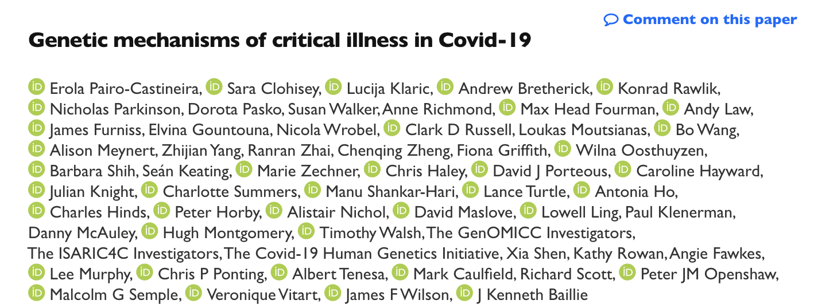
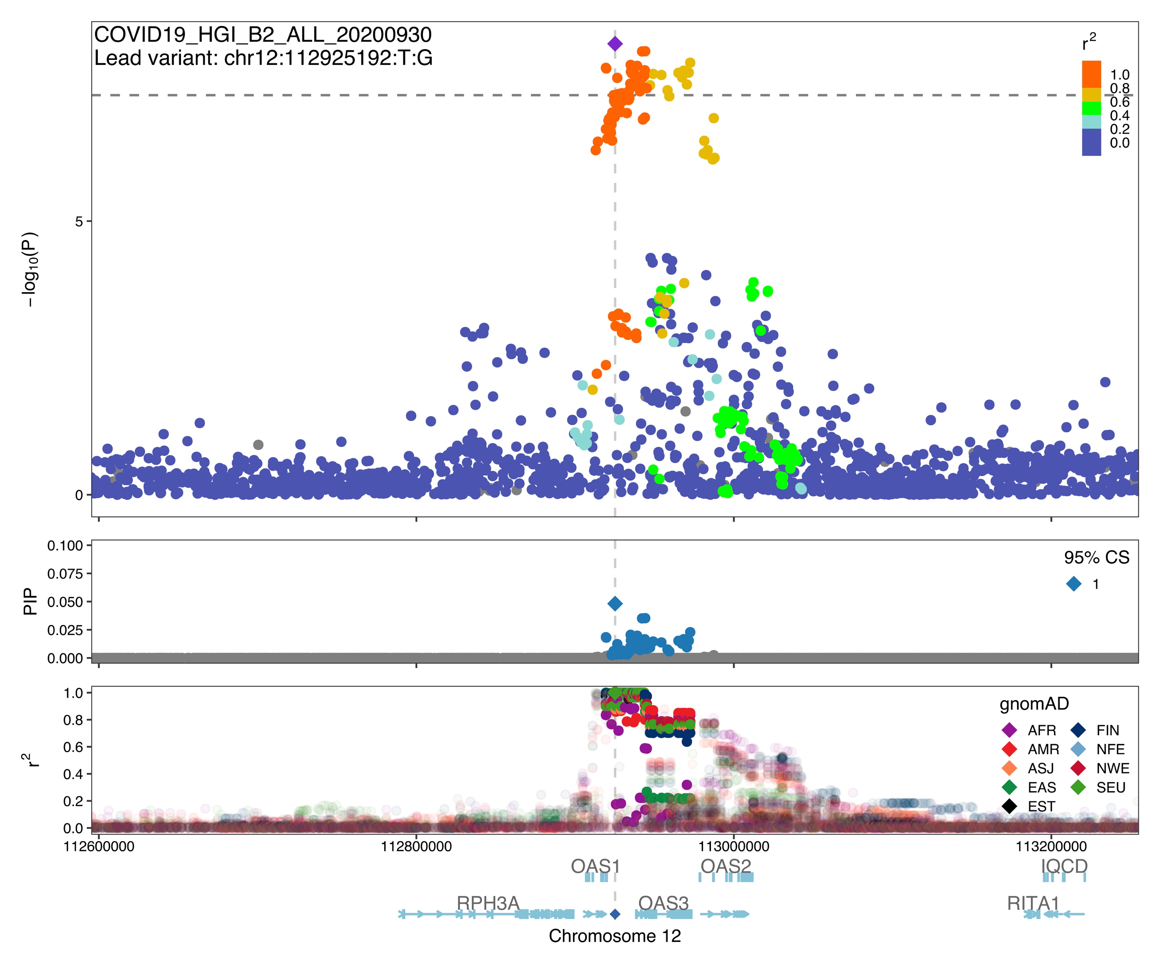
OAS gene cluster on chromosome 12
Sept 25
Gene cluster encoding antiviral restriction enzyme activators
Modest associations to reduced platelet count (UKBB) and chronic lymphocytic leukemia (protective) reported
Top SNP rs2269899
Beta= .12, p=5.3e-9

Slide 11
2 chromosome 19 associations
4.7 Mb - rs2277732 lead of set of 4 tightly linked SNPs intronic to DPP9 (others: rs12610495, rs2109070, rs2109069) previously associated to ILD/IPF
10.3 Mb - rs74956615 lead SNP – has high LD (r² > 0.8) to several other SNPs, including TYK2:P1104A (rs34536443) which did not appear in the top associations – what’s going on?

Slide 12
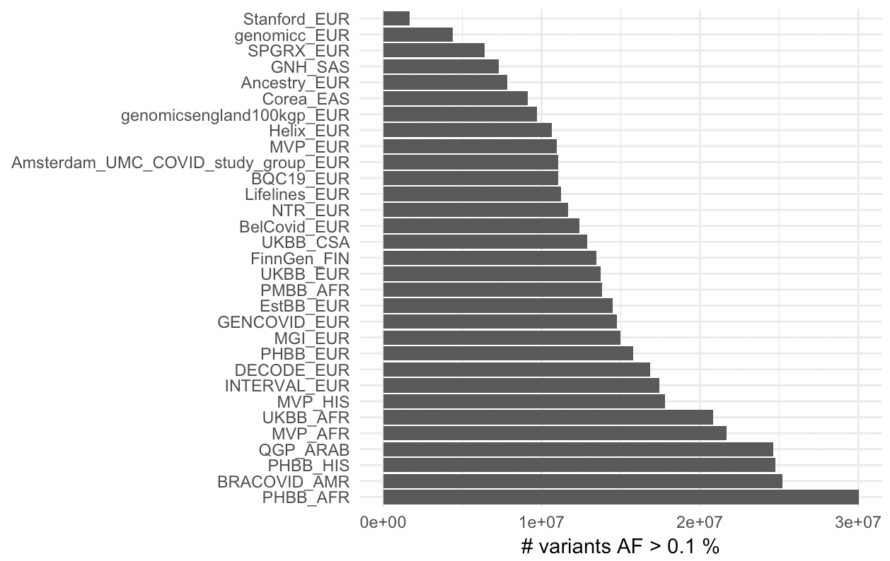
Variable numbers of variants available across studies, summary stats imputation necessary
Numbers of available variants per study differ
B2 chr 19 10.3 Mb association
 | RAVER1 3' UTR | TYK2 missense | KEAP1 3' UTR
#CHR | 19 | 19 | 19
POS | 10317045 | 10352442 | 10486312
rsid | rs74956615 | rs34536443 | rs45524632
all_meta_N | 13 | 13 | 14
all_inv_var_meta_beta | 0.33 | 0.28 | 0.48
all_inv_var_meta_p | 4.50E-09 | 5.25E-04 | 4.62E-09
inserting missing results based on LD partners:
all_meta_N | 14 | 14 | 14
all_inv_var_meta_beta | 0.34 | 0.37 | 0.48
all_inv_var_meta_p | 9.47E-10 | 1.79E-10 | 4.62E-09
^ not updated with latest data

Slide 13
TYK2
AITD RA corrected B2
rs74956615 2.2x10⁻¹⁹ 1.0x10⁻¹² 9.5x10⁻¹⁰
rs34536443 1.7x10⁻²³ 8.8x10⁻¹⁴ 1.8x10⁻¹⁰
P1104A
4% Ala allele is protective in autoimmunity, confers risk to severe COVID-19
Autoimmune hypothyroid & rheumatoid arthritis results taken from UKBB+FinnGen meta-analysis

Slide 14
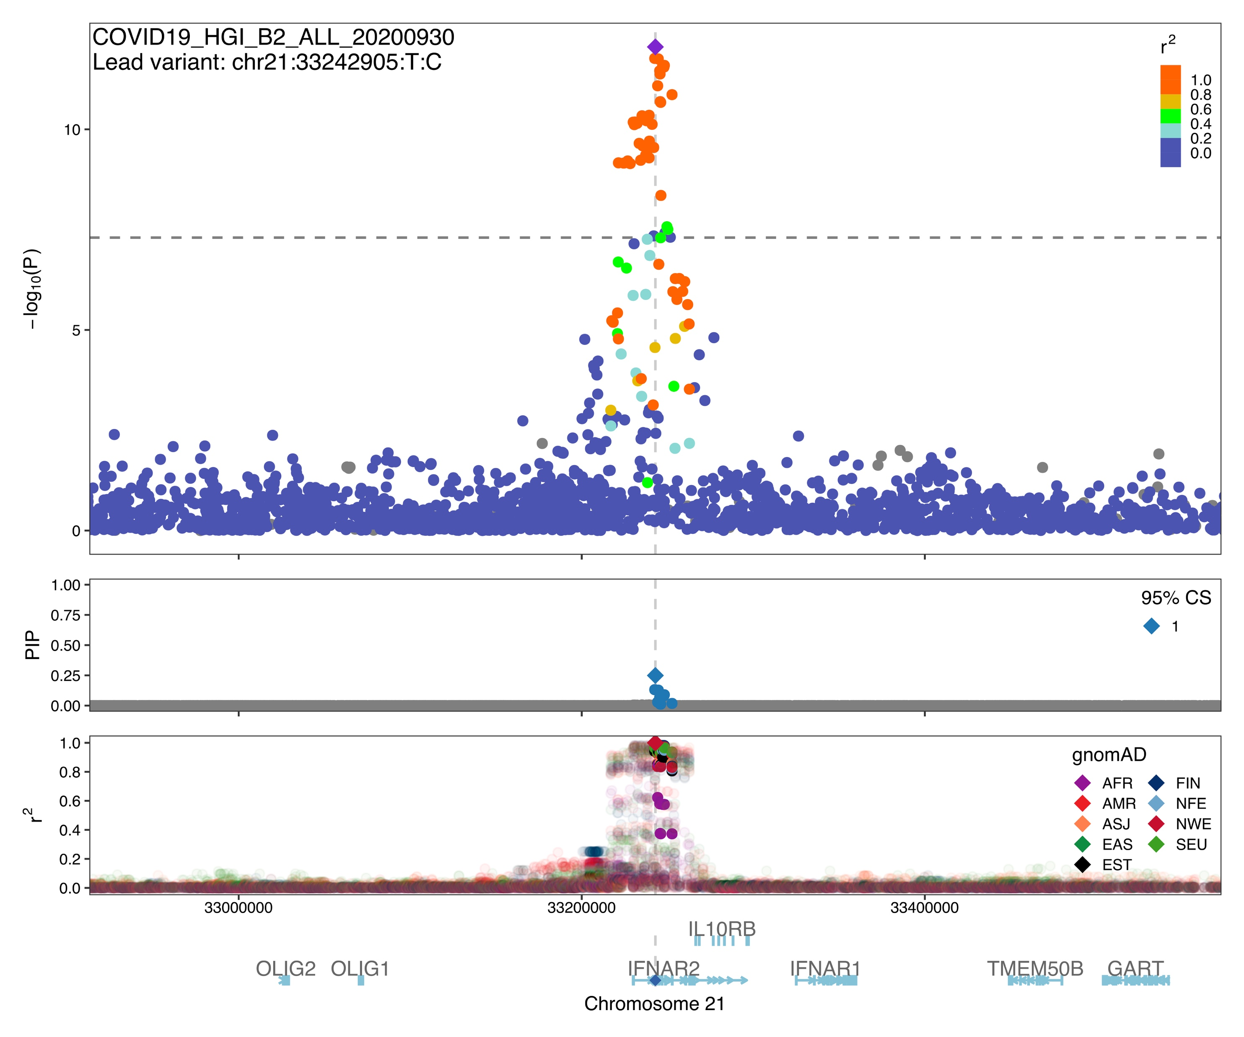
IFNAR2 / IL10RB / IFNAR1 on chromosome 21
Large set of SNPs in LD within gene footprint of IFNAR2 including missense variant in (IFNAR2:F10V rs1051393)
No obvious colocalizing GWAS hits
Top SNP rs13050728
Minor allele (35%) confers risk
Beta=0.16, p=1x10⁻¹³

Slide 15
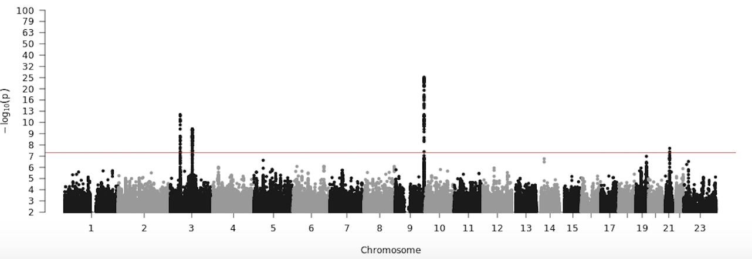
COVID-19 SUSCEPTIBILITY
30K PCR positives vs population
Novel association
100 SNPs in tight LD (r²>0.9)
Spanning: ZBTB11, RPL24, PDCL3P4, CEP97, NXPE3, NFKBIZ
Lead SNP rs12636046
Minor allele (35%) protects against infection
Beta=-0.06, p=3.7x10⁻¹⁰
No prior reported GWAS associations
Novel susceptibility
association
Chr3 severity locus –
Bleed-through from
inclusion of several severe
hospitalized cohorts
ABO

Slide 16
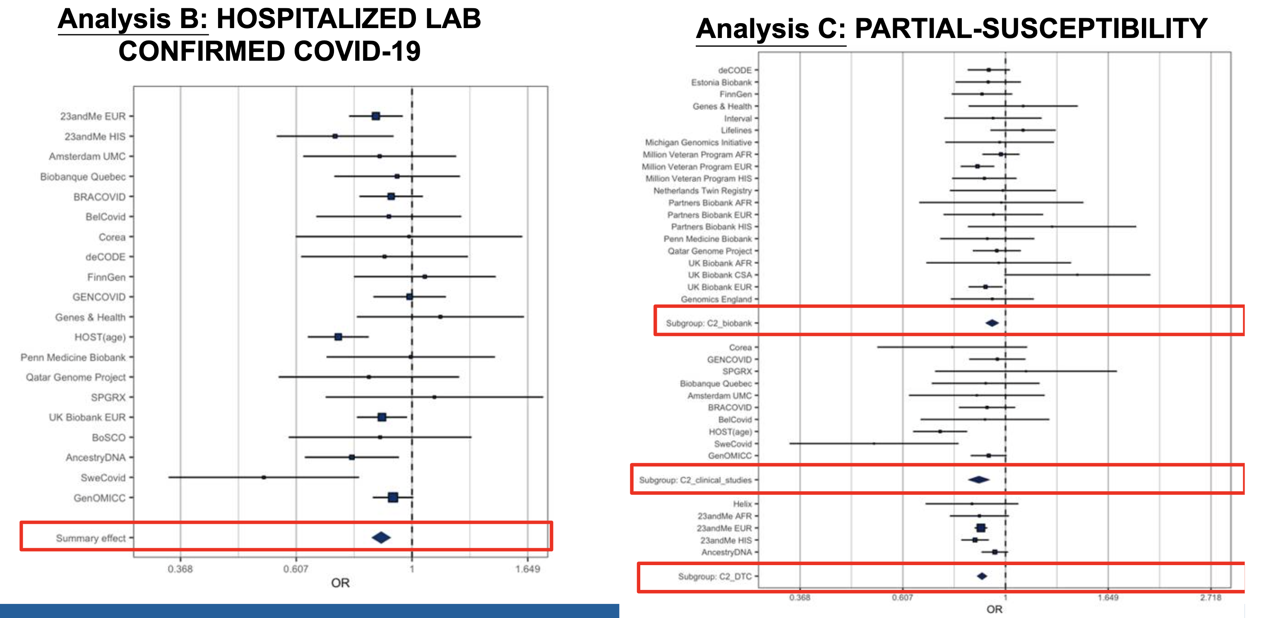
ABO locus association

Slide 17
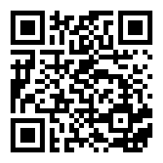
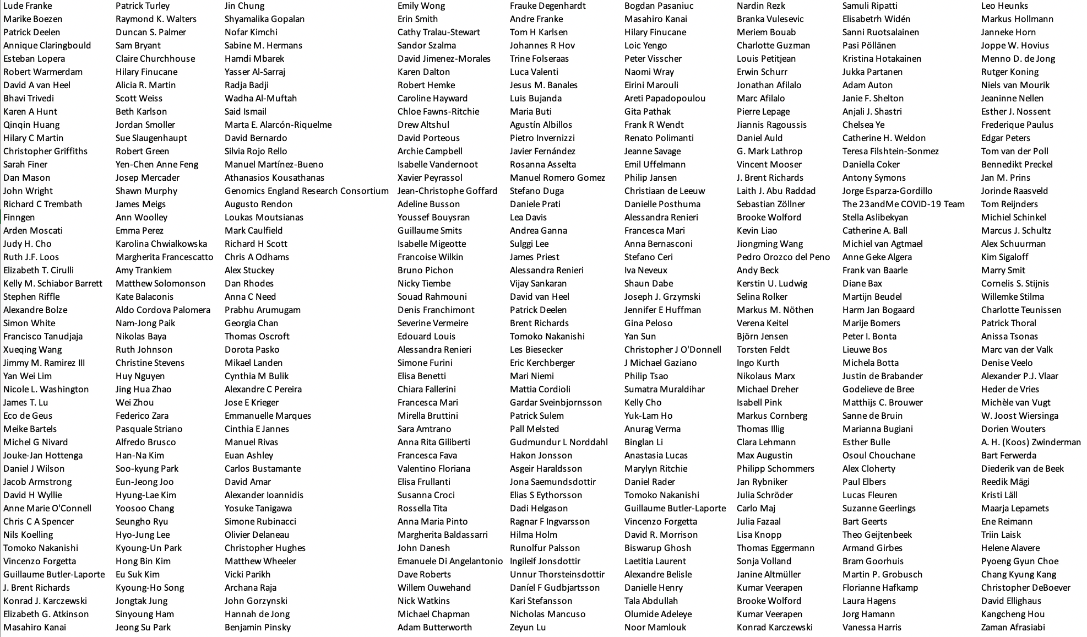
Acknowledgments - www.covid19hg.org/acknowledgements
Leadership
Mark Daly
Andrea Ganna
Rachel Liao
Ben Neale

